Slide 1


Strategisk partner for digitalisering, data, IoT
og softwareudvikling
Digital modulær
operations platform

Slide 2
Data, digitalisering og IoT
Konsultation og udvikling
Dokumentation
Digital strategi
Discovery workshops
Teknisk projekt definering
Softwareudviklingspartner
Sporbarhed
Digitale tvillinger
Bro mellem OT & IT
Machine learning
Maskinstyring
Process mapping
POWER BI KONSULTATION OG UDVIKLING
Databaser
PLC løsninger
Shopfloor og HMI løsninger
Automatiseringsløsninger
SCADA
CTS
Produktionsnetværk
On-premise løsninger (Opticloud on-premise)
Automatiserede rapporter
Live dashboards
Integrationer mellem systemer
INFRASTRUKTUR
AI assistenter
AI agenter
Apps
Opticloud (Digital Operations Platform)
ERP shopfloor, MES/MOM, IoT, OEE, CMMS, EMS, QMS, EHS, Planning, Ops Excellence, Document Management, Work Order Management,
Work Order Instructions, Dashboards og Rapporter
OPERATIONER
RÅDGIVNING OG EKSEKVERING

Slide 3
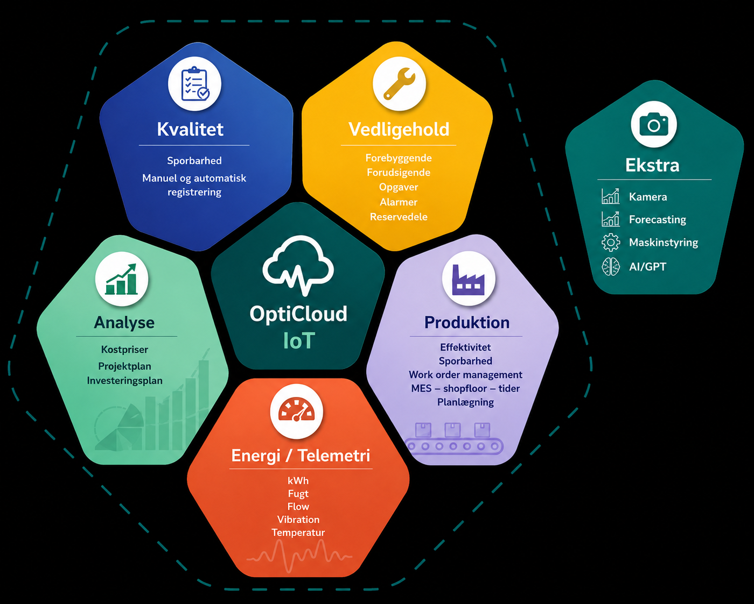
Opticloud
I skyen og on-premise

Slide 4
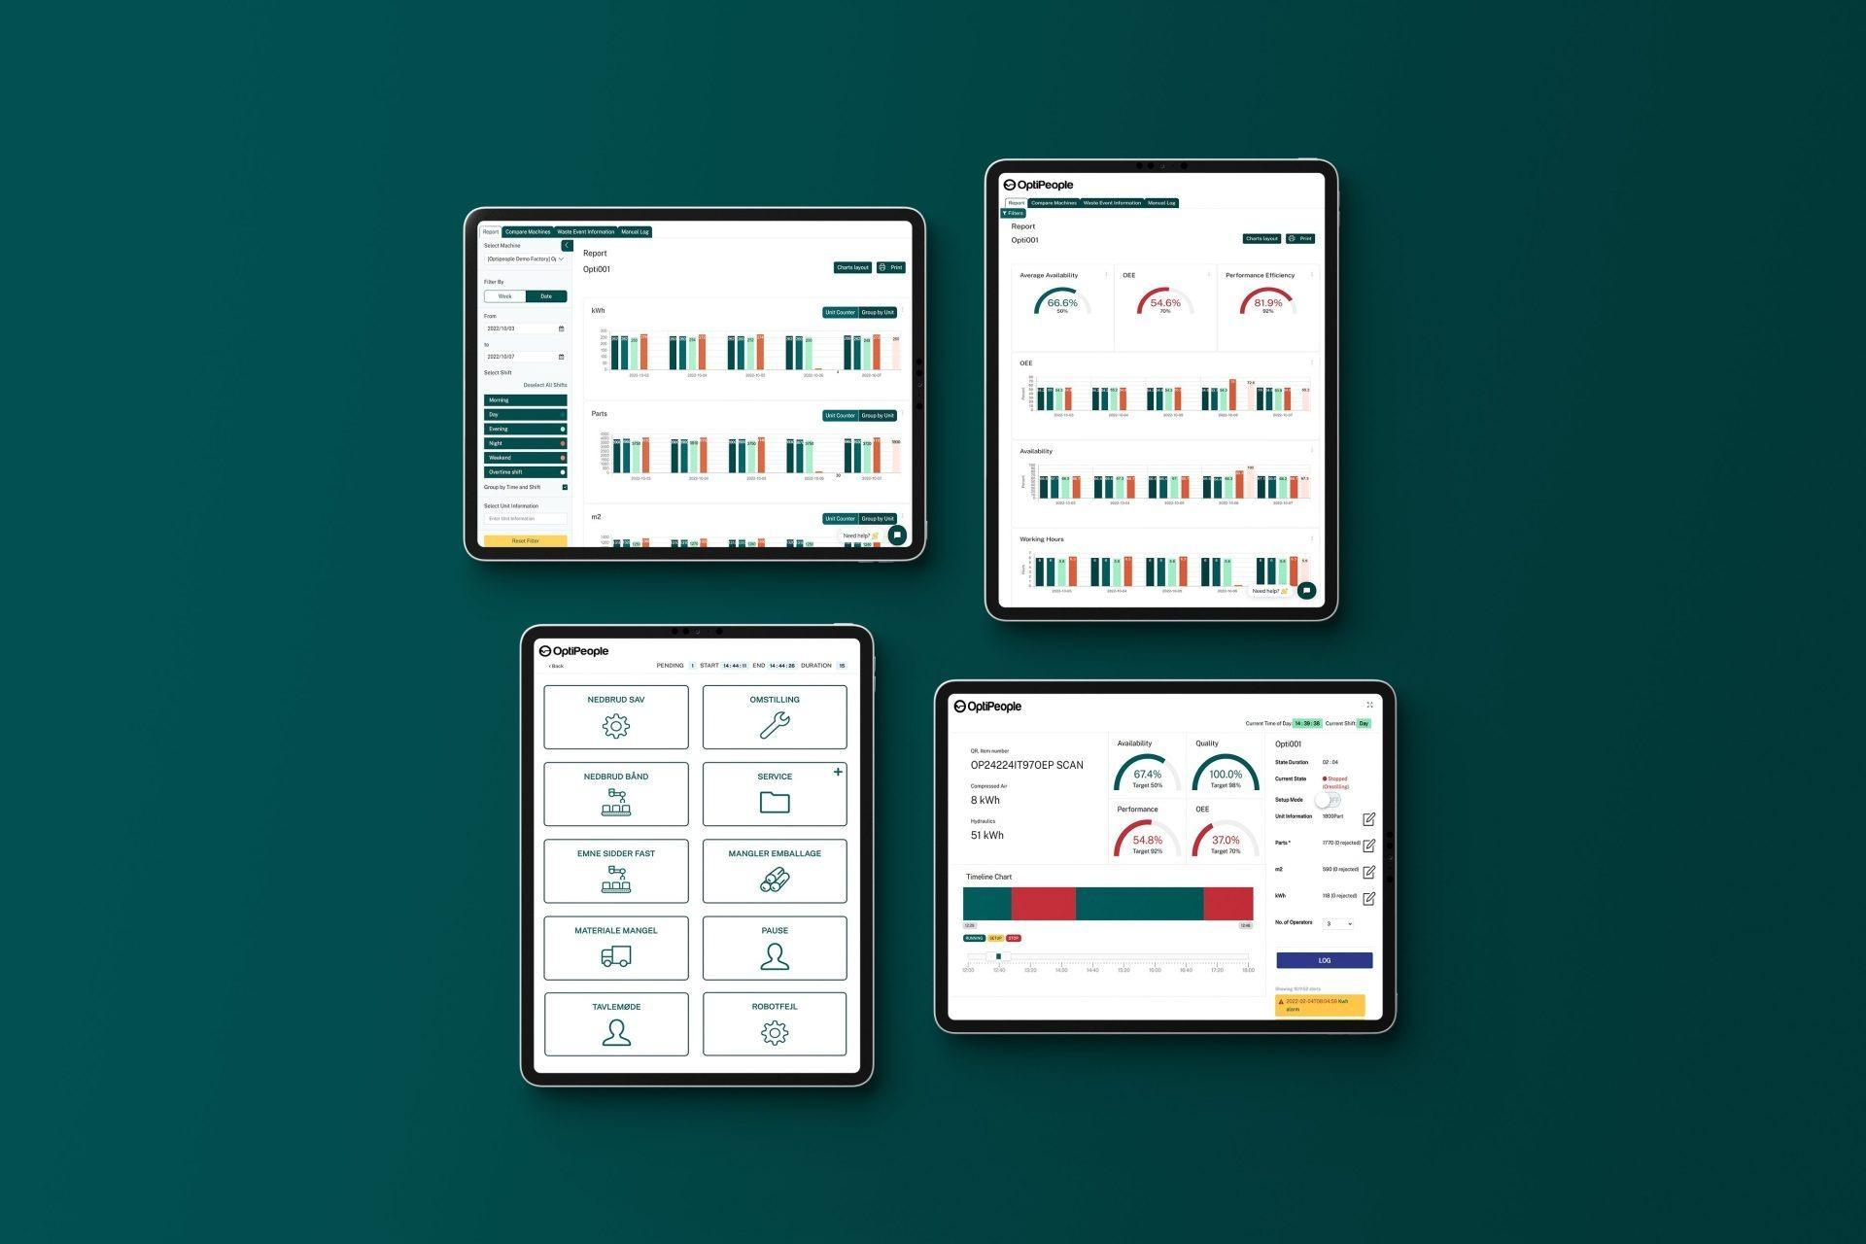
Opticloud (Digital Operations Platform)
AI assistenter
AI agenter
Apps
ERP shopfloor
IoT
MES/MOM
OEE
CMMS
EMS
QMS
EHS
Planning
Ops Excellence and Continuous Improvement
Document Management
Work Order Management
Work Order Instructions
Dashboards and Reports
OPERATIONER

